Slide 1


Practical Mobile Augmented Reality
Puneet Jain

Slide 2


Idea
Mobile Augmented Reality
Last year’s tax statements
Allow random indoor object tagging
Others should be able to retrieve
Faulty Monitor
Wish Mom Birthday
Return CDs
ACM MobiSys’15 (to appear) and “Best Demo” ACM HotMobile’15

Slide 3
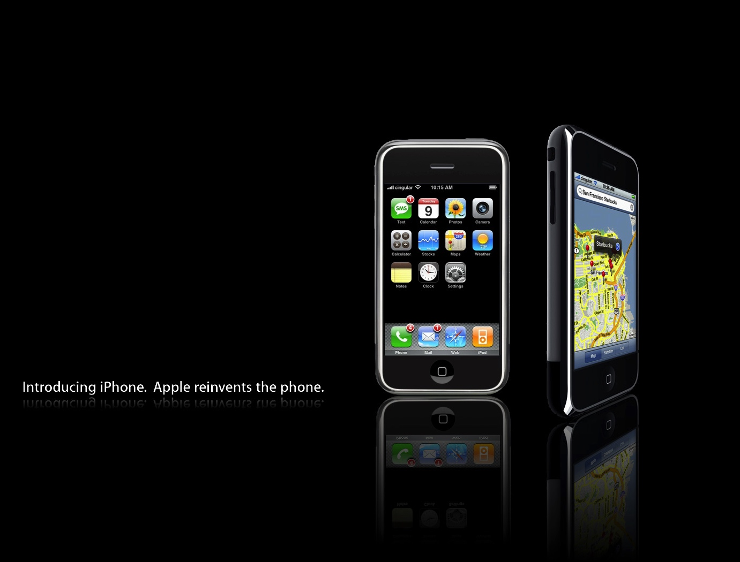
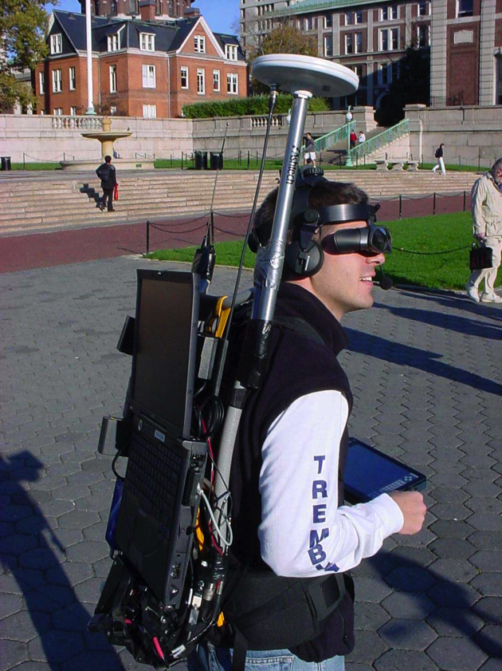
Mobile AR is Finally Here
Notes:
Back in 2007, when the first iPhone was announced… for many of us.. the vision of ubiquitous augmented reality seemed one step closer….almost at arms reach
People hoped that the ugly picture will soon transform into a system we always imagined.

Slide 4
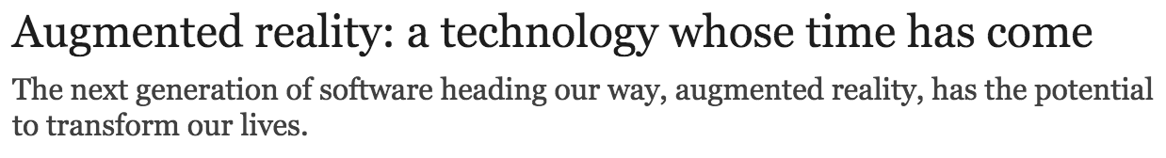

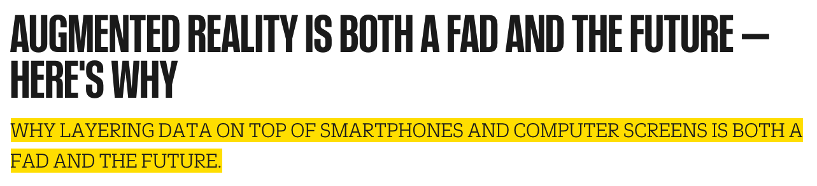

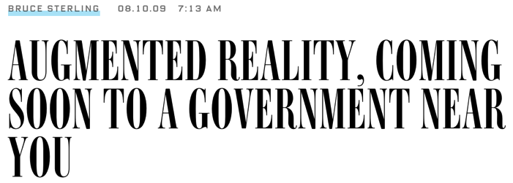
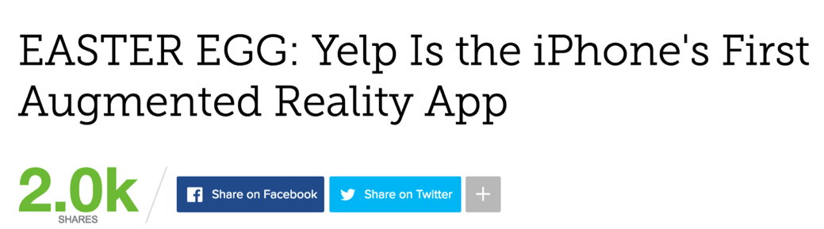
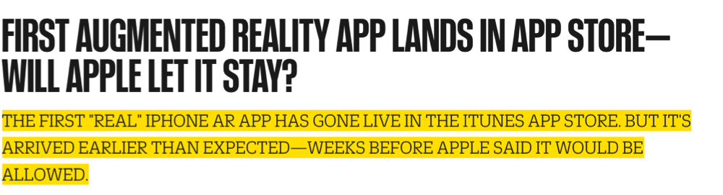

Mobile AR Forecasts: 2007-2009

Slide 5

Mobile AR is still not mainstream
8 years since first iPhone release ..

Slide 6
Why?
Need to understand today’s approaches
Vision
Sensing
Both necessary but not sufficient

Slide 7
Why vision ALONE not SUFFICIENT?

Slide 8
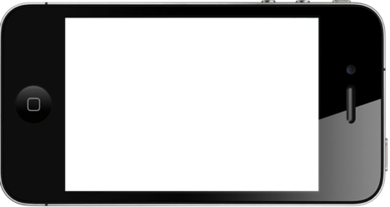
Vision
Sensing
Requires per frame feature extraction
Requires feature matching to existing database
Needs multiple views of the same object to train a model
Adding new objects require significant effort
Can’t distinguish similar looking objects or patterns
Botanist
Botanist
Image Database

Slide 9
Vision
Sensing
Accuracy is important
Per frame latency
Accurate Algorithms are Slow

Slide 10
Matching Latency
Vision
Sensing
Vision-only AR is slow, but accurate

Slide 11
Why sensing alone not sufficient?

Slide 12

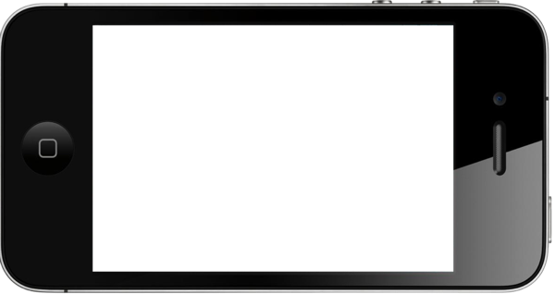
Vision
Sensing
Requires User Location
Requires User’s Orientation
Requires Object Location
New PoI can’t be added
Works for large structures
Gustave Eiffel, 1889
No alternative to sensing-only AR for indoors

Slide 13
Vision
Sensing
What would be requirements for indoors?
Indoor Location
Yaw
Indoor Orientation
No GPS, not feasible without indoor localization schemes
Roll
Sensing is Noisy Sensing-only AR is feasible only with location
Pitch
Requires compass, gyroscope, and accelerometer
Object Location
Gyroscope drifts >30 degrees in 5 minutes
Compass deviation
> 15 degrees
(x, y, z)
But sensors are fast, can help in real-time
Hard to estimate in uncontrolled environments

Slide 14
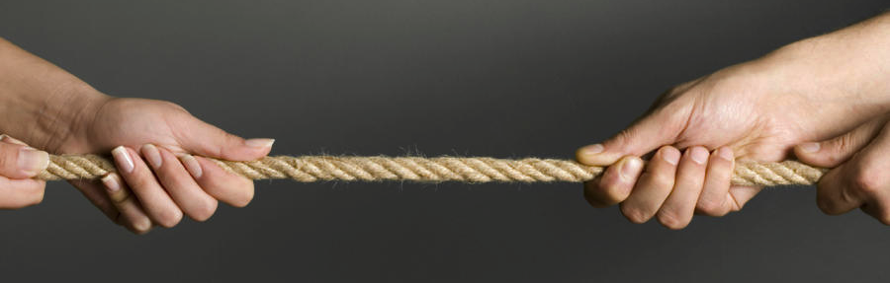
Vision
Sensing
Accurate/Slow
Quick/Inaccurate
Indoor Location
But, Indoor Localization is not always available
Can help vision in reducing computation
Prerequisites for Sensing
Notes:
Clearly there are tradeoffs between accuracy and latency … sensing and computer vision… offload or not to offload…and in todays talk.. That’s what our primary agenda is …

Slide 15
Location-free AR
Natural pause, turn, walk indicate spatial-relationships between tags
10 seconds
C
D
5 seconds
110°
80°
B
7 seconds
A
Sensors can help in building such geometric layouts
Geometry, instead of location, can be used to reduce computation burden on vision

Slide 16
OVERLAY: LOCATION FREE AR

Slide 17
OverLay Design Goals
High precision
Should work in indoor environment with repeated patterns: signs, logos, ceilings, ..
Ubiquitous applicability
Should not assume indoor location or precise orientation
Real-time operation
Should not degrade UI experience (fps)
Should allow addition of new tags
No new hardware
Should work on off-the-shelf phones
Notes:
We started this project considering it a engineering problem.. With the above goals… in the hope that we will be able to build a deployable system …

Slide 18







OverLay: Minimal Architecture
N
E
T
W
O
R
K
frame
SURF
Match
Refine
“Botanist”
frames
GPU Optimized Pipeline
Retrieve
Annotation DB
Annotate
(image, “Botanist”)
SURF Features

Slide 19
Engineering Limits
Function of DB size
SURF
Matching ≈1 sec
Extraction ≈ 29 ms
Accuracy ≈ 95%
Network ≈ 302 ms
GPU on Cloud
Many corner cases..
Matching latency too high for real-time

Slide 20
Latency
Accuracy
Database Size
Database Size
How to reduce database size?

Slide 21
Building Geometric Model
Temporal Relationships
Rotational Relationships
Visual Relationships

Slide 22
Temporal relationships

Slide 23


Inferring Temporal Relationships
TEMPORAL | ROTATIONAL | VISUAL
E
D
T=21, saw E
C
T=15, saw C
Temporal separations can be captured on cloud
B
T_{AB} ≤ 7 + E^{T}_{AB} T_{AB} ≥ 7 – E^{T}_{AB} T_{AC} ≤ 15 + E^{T}_{AC} T_{AC} ≥ 15 – E^{T}_{AC}
E^{T}_{AB}, E^{T}_{AC,} T_{AB,} T_{AC}≥ 0
T=7, saw B
A
T=0, saw A
Notes:
When phone is moving toward C, C can be prioritized for the matching.. Similarly when phone turns away from D, it can be removed from the candidate set

Slide 24
Many users ..
TEMPORAL | ROTATIONAL | VISUAL
E
D
C
B
Crowdsourcing can be used to capture relationships across many users
A

Slide 25
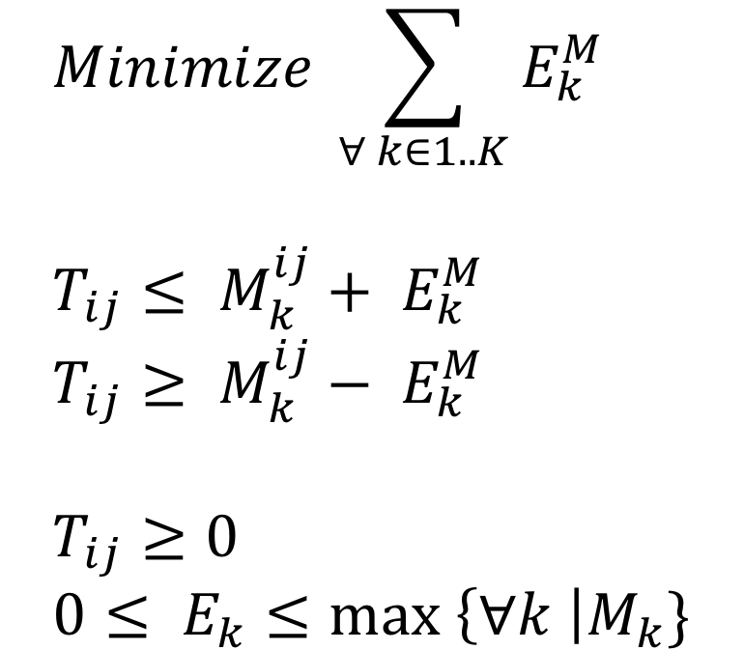
Solving for Typical Time
TEMPORAL | ROTATIONAL | VISUAL

Slide 26
Using temporal Relationships
TEMPORAL | ROTATIONAL | VISUAL
From LP: typical time between tag A and B = T_{AB}
Current time elapsed with error = (T_{CURRENT} – T_{A}) + E^{T}_{AB} if ((T_{CURRENT} – T_{A}) + E^{T}_{AB} > T_{AB} )
- Shortlist
E
D
T=T_{CURRENT}
C
B
E_{AB}
A
T_{CURRENT} - T_{A}
T=T_{A}
Time when the object is viewed

Slide 27
ROTATIONAL RELATIONSHIPS

Slide 28
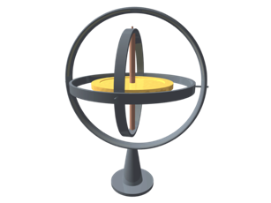
Inferring Rotational Relationships
TEMPORAL | ROTATIONAL | VISUAL
E
D
C
Gyroscope can capture angular separations
90° clockwise
B
110° anti-clockwise
R_{B} – R_{A} ≤ 20° + E^{R}_{BA} R_{B} – R_{A} ≥ 20° – E^{R}_{BA} R_{C} – R_{A} ≤ 130° + E^{R}_{CA} R_{C} – R_{A} ≥ 130° – E^{R}_{CA}
E^{R}_{BA,} E^{R}_{CA,} R_{A,} R_{B,} R_{C} ≥ 0
A
20° anti-clockwise
Notes:
When phone is moving toward C, C can be prioritized for the matching.. Similarly when phone turns away from D, it can be removed from the candidate set

Slide 29
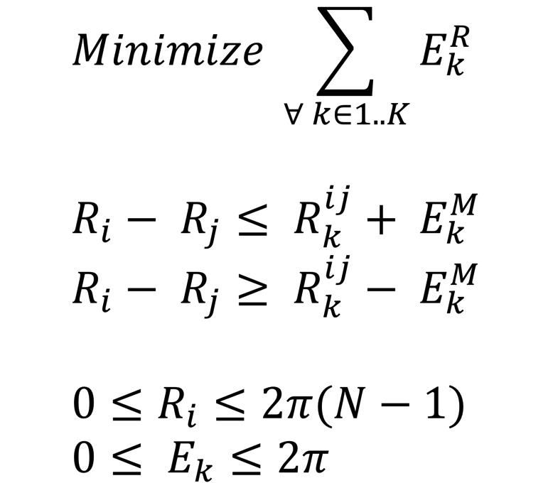
Solving for Typical Rotation
TEMPORAL | ROTATIONAL | VISUAL

Slide 30
Using Rotational Relationships
TEMPORAL | ROTATIONAL | VISUAL
E
D
R_{CURRENT} = R_{A} + Gyro
B
R_{D}
R_{B}
R_{E}
R_{A}
_{Gyro}
A
R_{CURRENT}
R_{B}
B’s rotational distance = R_{B} – R_{CURRENT} + E^{R}_{B}/2 Shortlist tags closer in rotational distance
E^{R}_{B}/2

Slide 31
VISUAL RELATIONSHIPS

Slide 32
Inferring Visual Relationships
TEMPORAL | ROTATIONAL | VISUAL
E
D
C
C
F
relationships can be inferred using Computer Vision
F
B
(1) C and F appear together (2) C is on the right of F
A

Slide 33
Using Visual Relationships
TEMPORAL | ROTATIONAL | VISUAL
If a visual relationship exists between A and B
User’s gyroscope reflects motion in B’s direction
Shortlist

Slide 34
CONTINUOUS UPLOADING

Slide 35
Feature Extraction Latency
30s
Phone
For Real-Time, Computation Offloading is Necessary
Latency
CPU on Cloud
1.5s
GPU on Cloud
29ms
Hardware
Notes:
If we talk about latency for feature extraction using SURF, phone is terribly slow. The shown latency numbers are for 1 HD frame.
CPU performs in the order of 1 second. GPU gives almost 3 order of magnitude improvement – mere 29 ms latency. Which seems to be very promising for AR where goal is to do feature extraction continuously.

Slide 36

Network Latency
Maximum 3 frame uploads in a second
302 ms/hd frame
Notes:
But such GPUs are only available on cloud, hence we will be network latency is another challenge.

Slide 37
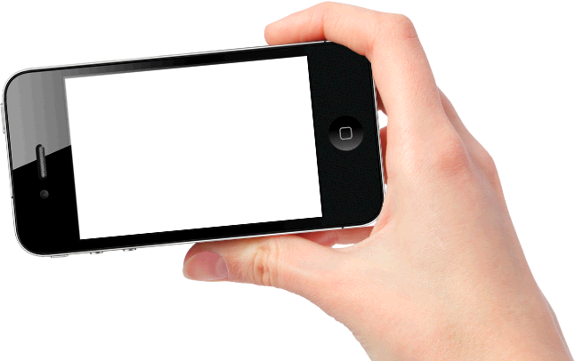

Selective Uploading
Micro hand motions
After a successfully upload, subsequent small hand motions are ignored
Uploading only the diff
Between subsequent frames, only the new part (A-(A∩B)) is uploaded
Blur detection
Designed lightweight canny based heuristic to detected blurred frames
A
A
B
A
B
I
Intermediate Blurred Frame
Notes:
Add animations for hand motion, use a DB and drop frames when hand is moving.. Same for other

Slide 38
Savings from Selective Uploading
> 40% frames are discarded on the device

Slide 39
3D-OBJECTS

Slide 40

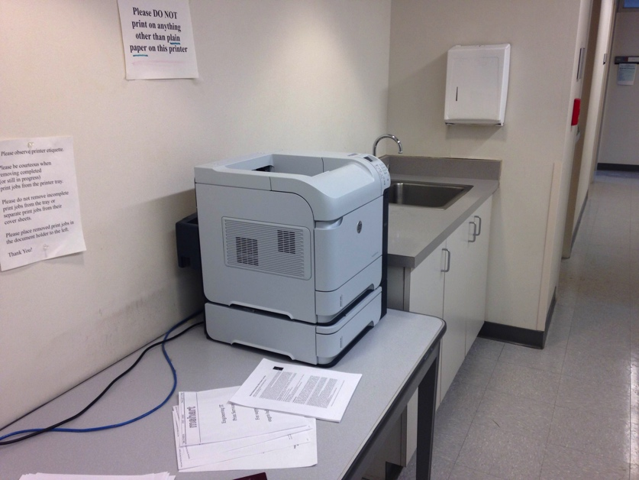

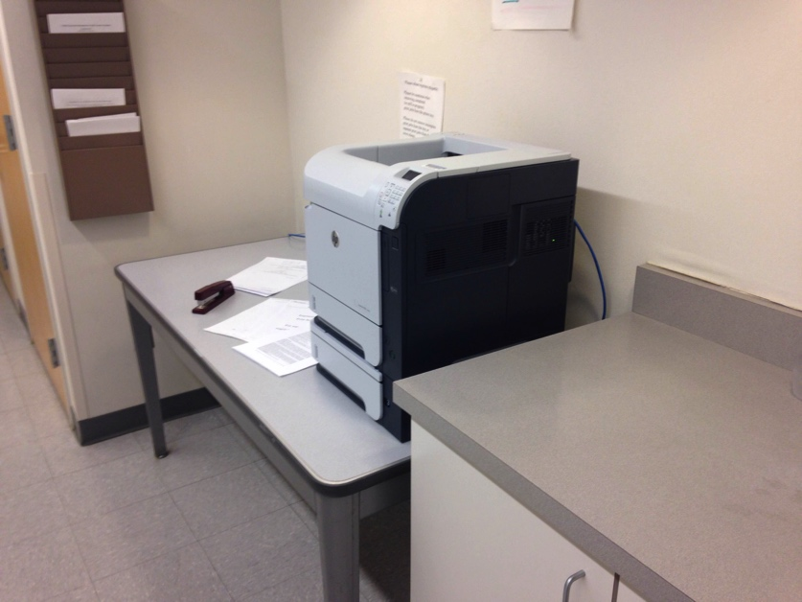

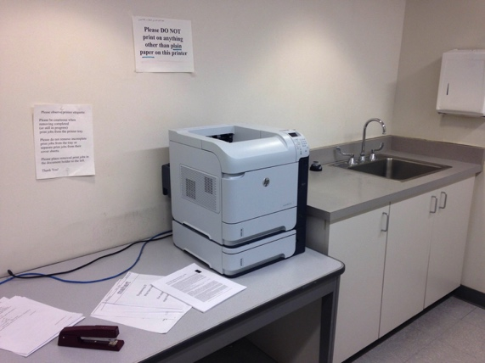
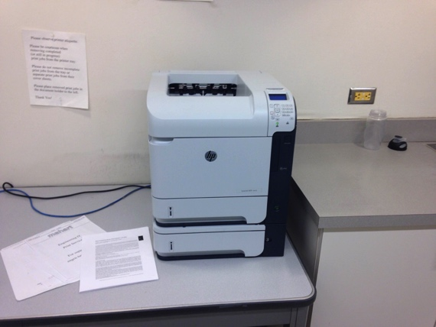
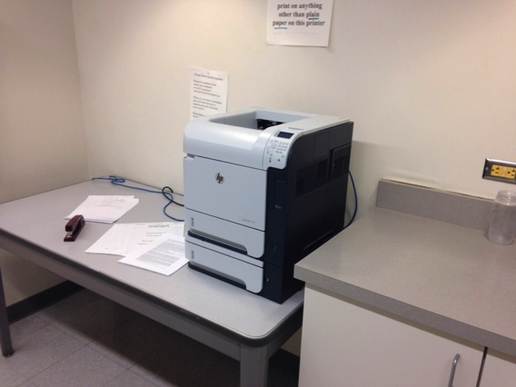
Handling 3D Objects: Learning
Tagged from particular angle
Retrieving from different angle

Slide 41



OverLay: Converged Architecture
N
E
T
W
O
R
K
frame
Frame Diff?
Blur?
SURF
Match
Refine
“Botanist”
(frames, sensors)
(time, orientation)
GPU Optimized Pipeline
Hand Motion?
Selected candidates
Annotation DB
Annotation DB
Learning
Retrieve
Select Candidates
Annotate
Update modules
Sensory Geometry
Visual Geometry
Macro-trajectory
Micro-trajectory
Linear Program
Spatial reasoning
(image, “Botanist”)
SURF

Slide 42
Overlay Evaluation

Slide 43
OverLay Demo
https://www.youtube.com/watch?v=vQwUWZ-7Qd0
Notes:
Going forward, I would set ones expectation from Mobile AR. I have video demonstration of an AR system which help in understanding our objective better.

Slide 44
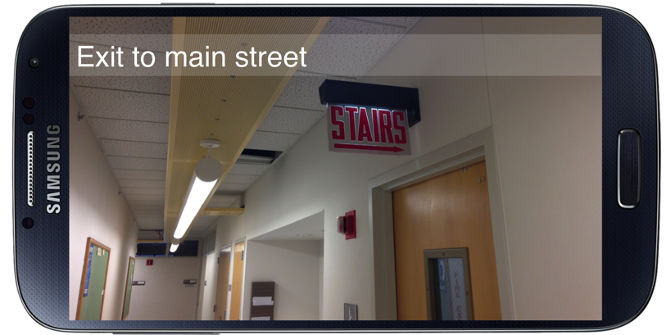
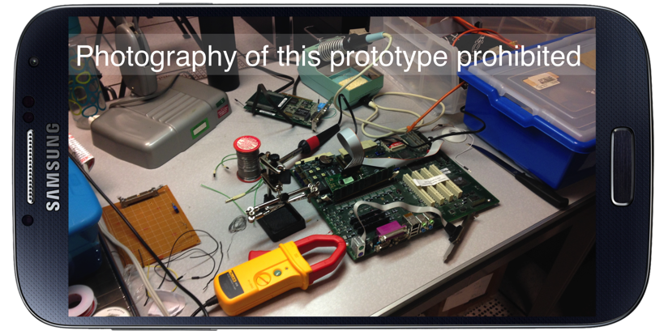

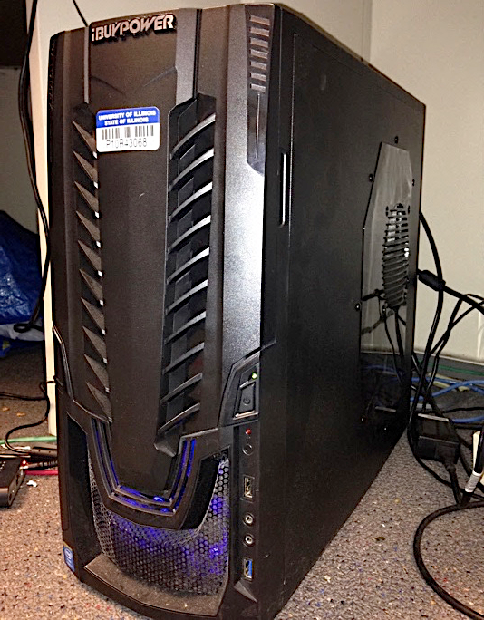

Evaluation Setup
Android App/Samsung Galaxy S4
Server: GPU on Cloud 12 Cores, 16G RAM, 6G NVidia GPU
11 Volunteers 100+ Tags
4200 Frame Uploads

Slide 45
System Variants
Approximate (Quick Computer Vision)
Matching using approximate schemes e.g., KDTree
Conservative (Slow Computer Vision)
Matching using brute-force schemes
OverLay
Conservative + Optimizations
OverLay after Learning
OverLay+ Learning

Slide 46
Latency
Optimizations lead to 4 fold improvement

Slide 47
Accuracy: Precision
Precision ≈ Bruteforce

Slide 48
Accuracy: Recall
Recall < Bruteforce

Slide 49
Accuracy: After Learning
Recall > Bruteforce and Precision ≈ Bruteforce

Slide 50
Past Projects contributing to Mobile AR

Slide 51

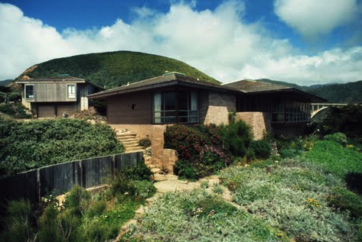


$7.8M
I wonder how much it costs to live there!
207 Coast Road
Distant Object Localization
OPS, ACM MobiSys 2012
Notes:
Consider another example in outdoor. Consider so-called “browsers” for immersive, augmented-reality.
In a browser app, users hold up their phone to for information about the world in-view around them.
For example, what if we were standing at a vista point on this highway?
We might hold up our phone over this bridge for information about it.
In fact, the Google Googles augmented reality service might be able to tell us that this is Bixby Bridge.
The reason it might be able to answer, is because this is an often-photographed landmark. Utilizing image-recognition techniques, Google Googles can corelate this view with a database of many pre-existing photographs.
But, when I found this photograph, what I wanted to ask was actually a very different query. I saw the house on top of the hill and wondered how much might such prime real-estate cost.
This, however, is not a well-known landmark. And thus, Google Googles does not apply.
Imagine that instead we could figure out the location, the address, of the home. Then, we could do a simple query on something like Zillow to get a tax-assesment, and answer my question.

Slide 52
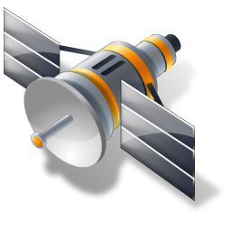
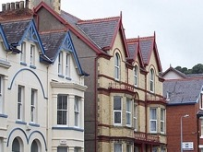
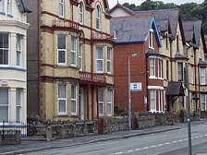
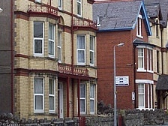
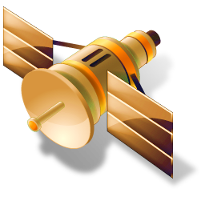
Noisy GPS
Noisy Compass
Noisy GPS
Erroneous Object Location
Noisy Compass
y
y
z
z
x
x
3D Model
3D Model
Multiple Photographs
y
z
x
3D Model
Improved GPS
Improved GPS
Better Object Location

Slide 53
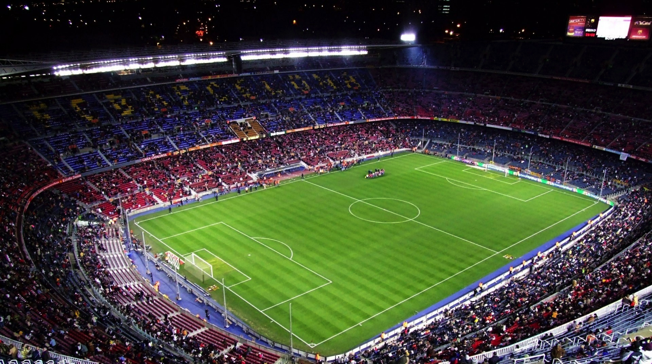


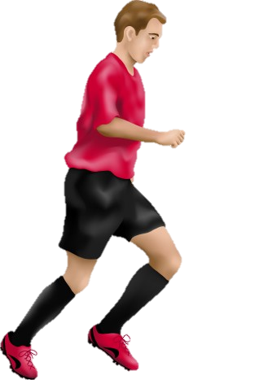

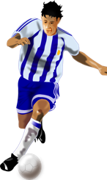
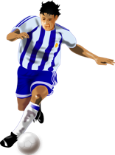
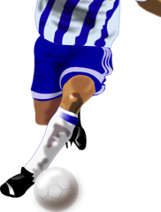
Clustered by shared subject
FOCUS, ACM SenSys 2013
Notes:
Such as this.
Imagine you are in a football stadium, watching this live game with 70K other people. This is an interesting moment in the game, and a small fraction of users decide to film and live stream it to some video sharing service. Imagine consumers of this content, if presented in with all these stream, will be overwhelm with the amount of data. As humans by nature, users will capture only a few interesting points in the stadium, will capture this event, may be goal keeper and striker. Wouldn’t it be nice if we can cluster them together? This is what FOCUS is enabling

Slide 54

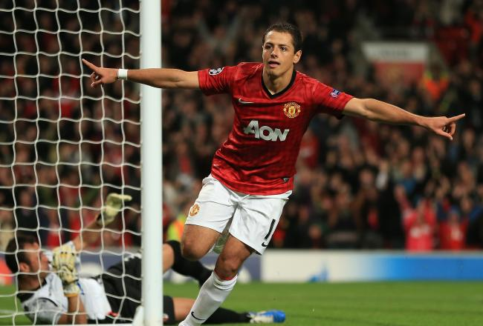
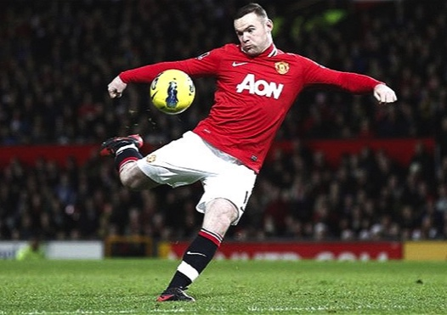

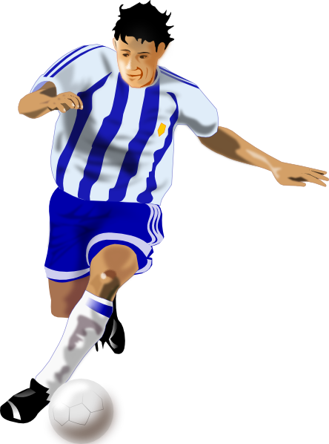
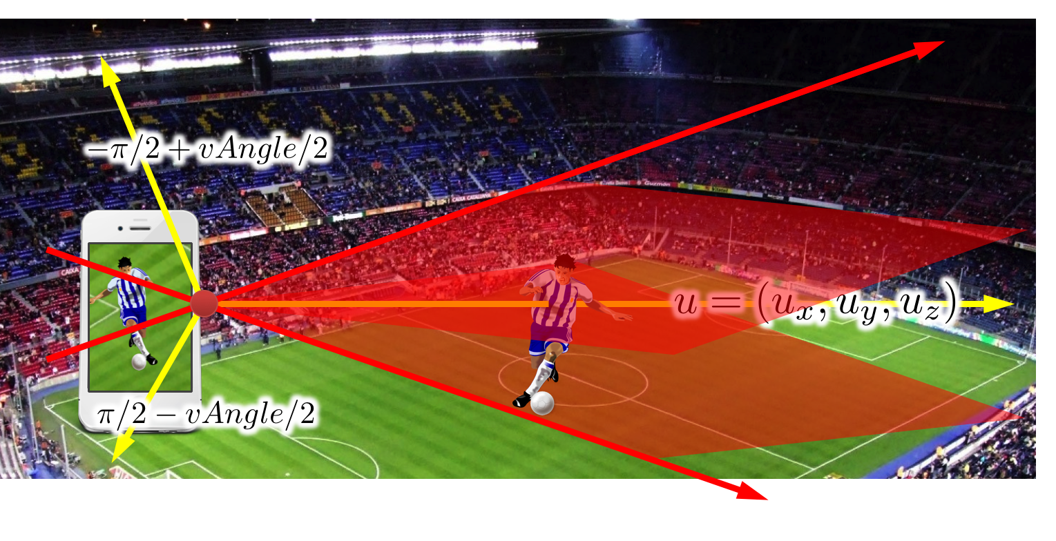
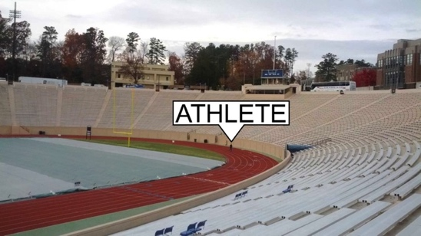
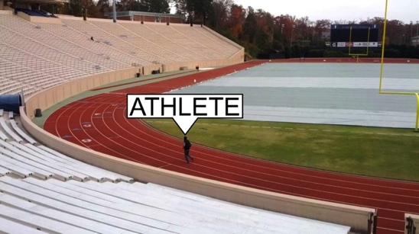
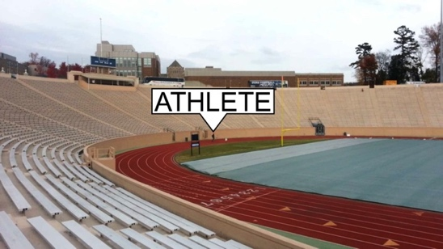
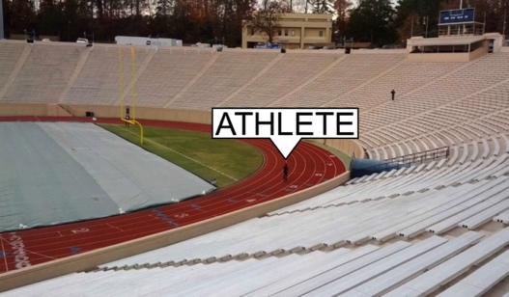





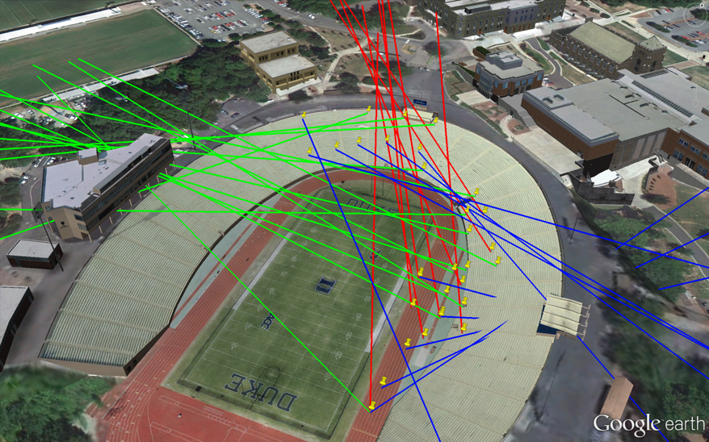
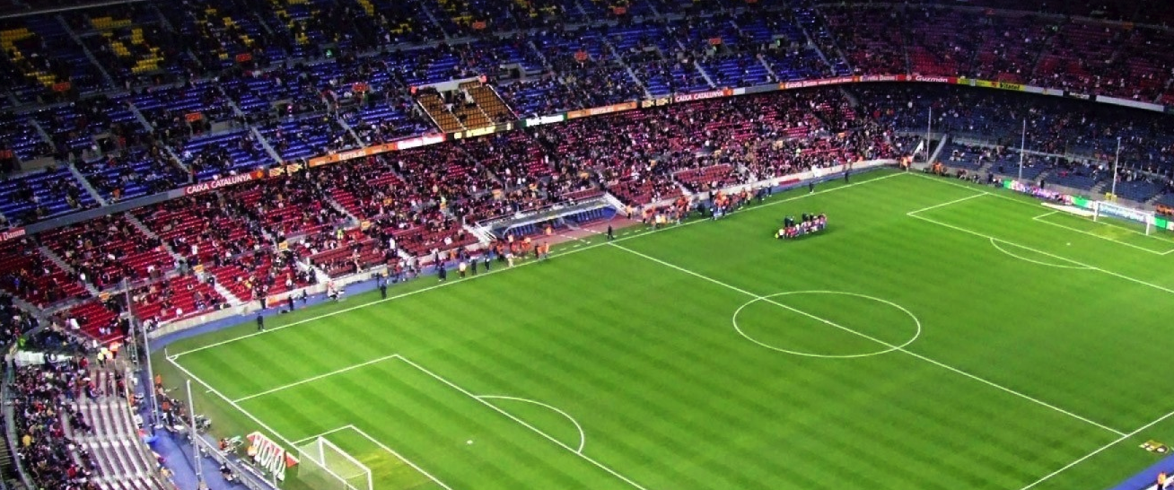
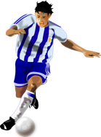




y
z
x
VISUALLY similar, LOGICALLY different
Phone’s location and orientation
3D Model of the venue
Video frames from phone
LOGICALLY similar, VISUALLY different
Phone’s location and orientation
Gyroscope
Real-time Camera Pose
IMPRECISE Sensing, DYNAMIC Subjects, REAL-TIME
Real-time Camera Pose
Vision on Cloud
Real-time Clustering

Slide 55
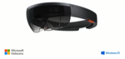

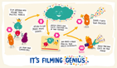



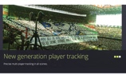






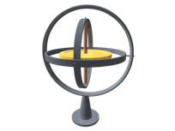
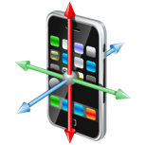










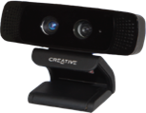
Conclusion
Image and Location based AR
Faster Vision, Accurate Sensing
Mobile AR, Video Analytics, Object Localization
Sensor Augmented Vision and Future ..

Slide 56


Thank you
www.cs.duke.edu/~puneet
Joint Work
Justin Manweiler (Internship Mentor) IBM T. J. Watson Research
Romit Roy Choudhury (Advisor) UIUC

Slide 58


Future Directions
Logical Mapping for Indoors
Indoor localization is “almost” mainstream
The next big challenge is to generate indoor maps at a massive scale
Intuition derived from
Sensor and WiFi Fusion for fast and accurate 3D reconstruction
3D Mapping using crowdsourcing
logical location assignment in vision generated maps

Slide 59

Future Directions
Software Defined Toys
Parents complain about kids watching excessive television
Avoid side effects: violent behavior, bad food habits, less creative, health issues
Increasing similar trend toward phones and tablets
Merging television watching experience with software defined toys
How to keep kids away from phone/tablets yet, keep them engaged in activities
Combining reaction sensing and activity recognition with video watching

